Slide 1



Slide 2
01
INTRODUCTION
DATA COLLECTION
02
TABLE
OF
CONTENTS
DATA PRE-PROCESSING
03
04
EXPLORATORY DATA ANALYSIS
05
CONCLUSION

Slide 3
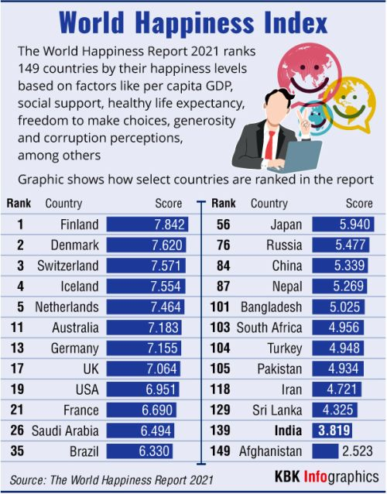
WHAT IS HAPPINESS?
Many of us do not need a formal definition for the word. It is something we know ,when we feel it.
The World Happiness Report is an annual report that ranks the global happiness of over 150 countries. “Happiness” in this instance,is calculated by summing the values from seven criteria.The data comes from the Gallop World Poll,which asks participants to rate question on a scale of 0 to 10.How happy are you?

Slide 4
DATA COLLECTION
The dataset was obtained from Kaggle and contains the 2015-2021 World Happiness Reports.
Each dataset has the following columns of which I have given a brief description.
GDP : Shows a country's GDP divided by its total population
Social Support : Metric estimating satisfaction of people with their friends and family
Life Expectancy :The number of years a person can expect to live
Freedom to make Life Choices: Perception of freedom quantified.
Generosity: Numerical value estimated based on the perception of Generosity experienced by poll takers in their country.
Perceptions of Corruption : A quantification of the people’s perceived trust in their governments.
Happiness Score:The sum of all numerical columns in the datasets.

Slide 5
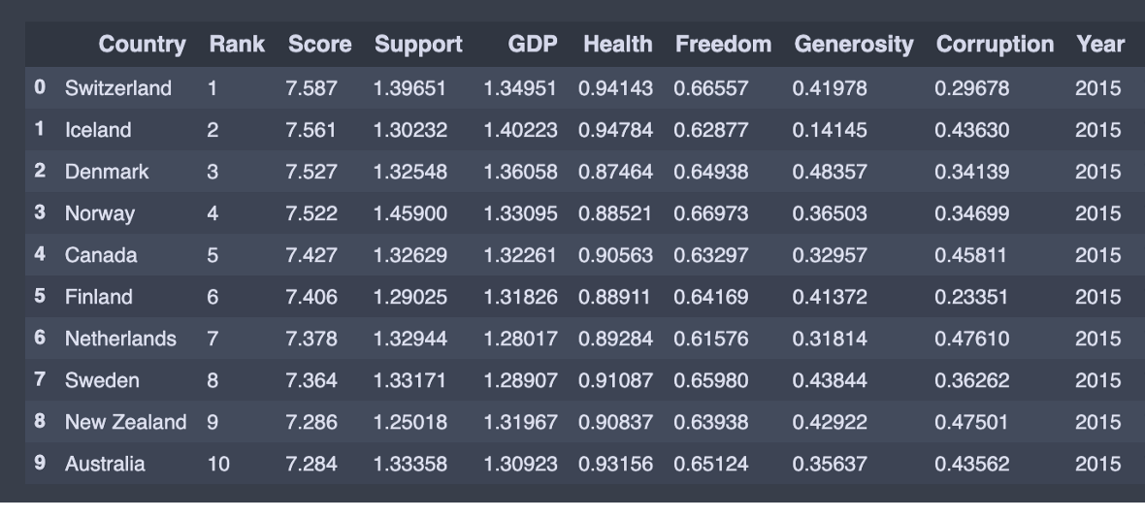
This is the dataset of world happiness report 2015

Slide 6
DATA PRE-PROCESSING
Preprocessing is the process of doing a pre-analysis of data, in order to transform them into a standard and normalized format.
I have done the preprocessing of data using the pandas library.
Preprocessing involves the following aspects:
missing values.
data standardization.
data normalization.
data binning.

Slide 7
Why Data Preprocessing?
In the real world data are generally incomplete.
Lacking attribute values
Lacking certain attributes of interest or containing only aggregate data.
Noisy: containing errors or outliers.
Inconsistent: containing discrepancies in codes or names.

Slide 8
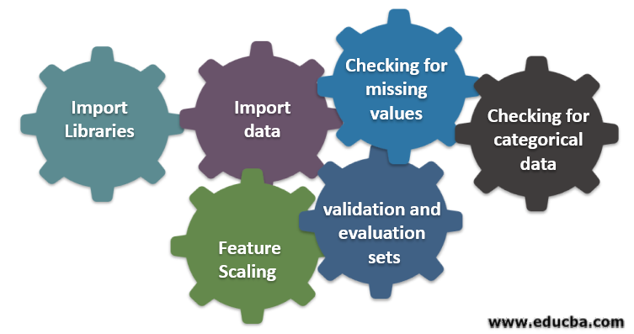
Steps in Data Processing

Slide 9
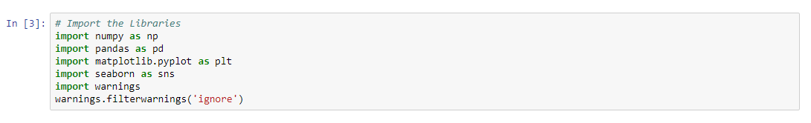
Import the Libraries
This is how we import libraries in Python using import keyword and this is the most popular libraries which any Data Scientist used. (I used- Jupyter Notebook)
NumPy is the fundamental package for scientific computing with Python.
Pandas is for data manipulation and analysis. Pandas is an open source, BSD-licensed library providing high-performance, easy-to-use data structures and data analysis tools for the Python programming language.
Matplotlib is a Python 2D plotting library which produces publication quality figures in a variety of hard copy formats and interactive environments across platforms.

Slide 10
Seaborn is a Python data visualization library based on matplotlib.
It provides a high-level interface for drawing attractive and informative statistical graphics.
Warning messages are typically issued in situations where it is useful to alert the user of some condition in a program, where that condition (normally) doesn’t warrant raising an exception and terminating the program. For example, one might want to issue a warning when a program uses an obsolete module.

Slide 11
Import the Dataset
By using Pandas we import our dataset and the file I used here is .csv file.
To access and to use fastly we use CSV files because of their light weights.
After importing the dataset, you can see we use head function .
This function returns the first n rows for the object based on position.
It is useful for quickly testing if your object has the right type of data in it. By default it returns 5 rows.

Slide 12
Check out the Missing Values
The concept of missing values is important to understand in order to successfully manage data.
If the missing values are not handled properly by the researcher, then he/she may end up drawing an inaccurate inference about the data.
Due to improper handling, the result obtained by the researcher will differ from ones where the missing values are present.
Two ways to handle Missing Values in Data Preprocessing
Drop the Missing Values
2. Replace the Missing Value

Slide 13

Identification of variables and data types.
Analysing the basic metrics.
Non-Graphical Univariate Analysis.
Graphical Univariate Analysis.
Bivariate Analysis.
Variable transformations.
Missing value treatment.
Outlier treatment.

Slide 14
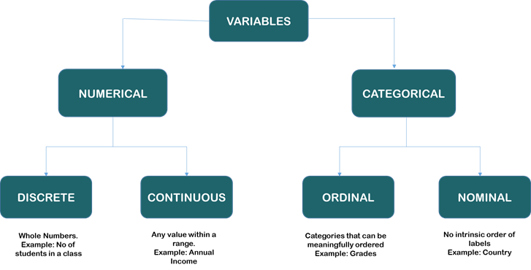
Identifying the variables

Slide 15
Data Visualization
Exploratory data analysis is a simple classification technique usually done by visual methods.
Analyzing data using simple tools from statistics, simple plotting tools.
With the use of charts and certain graphs, one can make sense out of the data and check whether there is any relationship or not.

Slide 16
Common graphs used while performing EDA:
Scatter Plot
Pair plots
Histogram
Box plots
Pie charts
Heat Map
Line plots

Slide 17
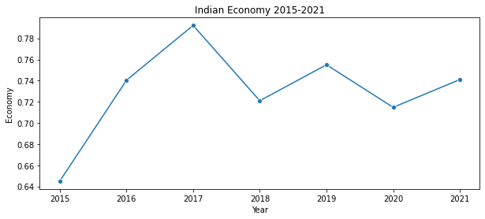
First Let’s begin with Analysing India’s GDP rate(Economy rate) from 2015 to 2021
There are certain peaks with regards to
Economy as seen in the years 2016 and
2017.
A drop as seen in the year 2018 .
There is a slight peak in the economy in
year 2019 compared to 2018.
In 2020,The economy has dropped down
And in 2021,its little improved.

Slide 18
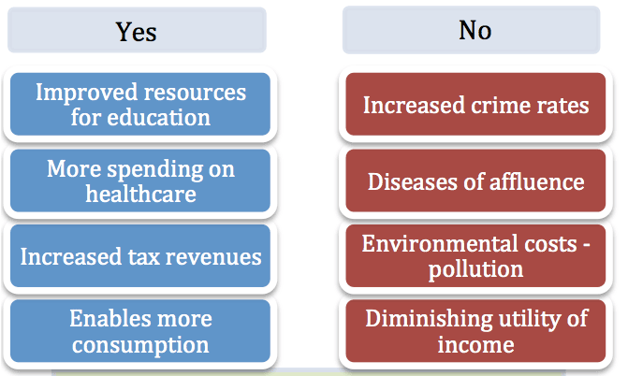
Does Economic growth bring Happiness?

Slide 19
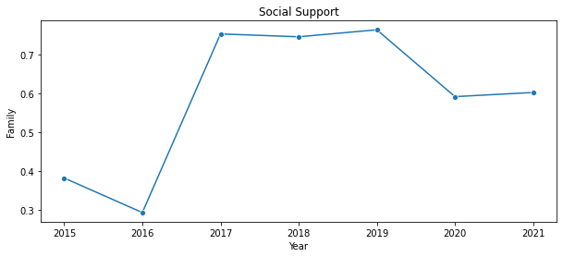
Social Support of India from 2015-2021
There are distinct highs in 2017,
2018 and 2019, 2016 being the
lowest.In 2020 and 2021 ,India’s
social support is on a decreasing
trend compared to earlier years.

Slide 20
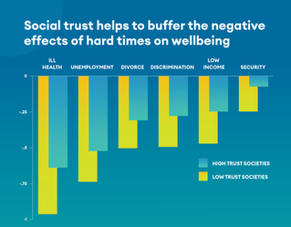
This insight is very helpful in understanding the effect of strong communities in difficult times.
The global COVID-19 coronavirus pandemic poses great risks to well-being, especially health and income.
People are pleasantly surprised by the willingness of their neighbors and institutions to work together to help each other.
This has sometimes led to surprising increases in happiness.

Slide 21
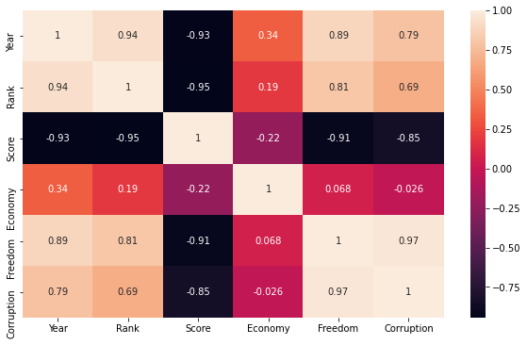
To find correlation between Economy,Freedom of life,Trust on government(in terms of corruption) of India

Slide 22
1.How is Economy related to Happiness Score?
From the heatmaps,Correlation coefficient between Economy and Score is -0.22 indicating a negative
relationship between the satisfaction of citizens with the economy and the Happiness score.
GDP_per capita(Economy) is a trackerof the economic growth of a country. People in countries
showing Positive growth rate of economies tend to be more happier as it leads to higher incomes and
better standards of living. But In India, the Economy is not satisfied with the Government.
Relation of Freedom to Happiness Score?
The correlation between Freedom and Score is -0.91 indicating a negative relationship
between the perception of Freedom and the Happiness Score of a country. Generalising this
perception of freedom is a hard task
because according to research it is different for people. Nevertheless, it is still a significant
contributor to the Happiness Score of a nation.
How does corruption affect the Happiness score?
Correlation coefficient between corruption and Score is -0.85. This indicates a negative
relationship between perception of corruption and the happiness score of a country.

Slide 23
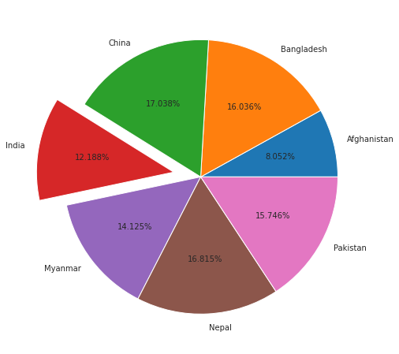
Analyse on India’s neighbouring Countries
Which country has the highest happiness score?
The happiness score of India and neighbouring countries are plotted in as a pie chart. From this,we can observe that in 2021,China has the highest happiness score.
And India is in the 5th position

Slide 24
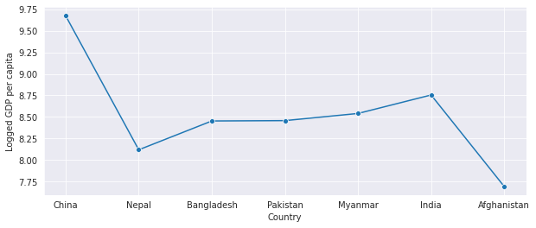
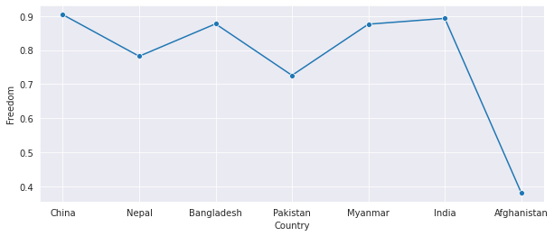
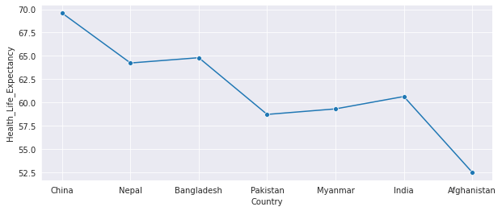
India’s rank among neighbouring countries in terms of Economy,Life Expectancy and Freedom in 2021

Slide 25
Among neighbouring countries, India ranks 2nd in the GDP per capita (Economy)
Among neighbouring countries, India ranks 2nd in the Freedom to make life choices.
India ranks 4th in terms of Healthy life expectancy

Slide 26
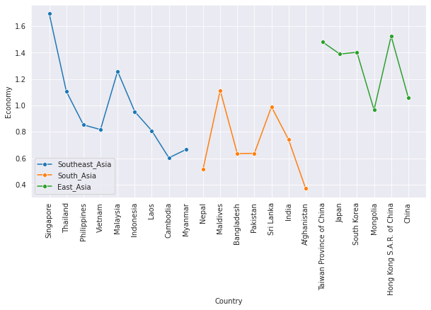
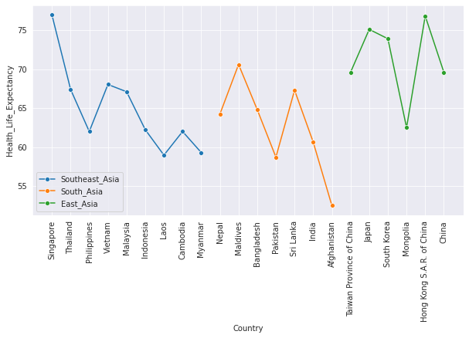
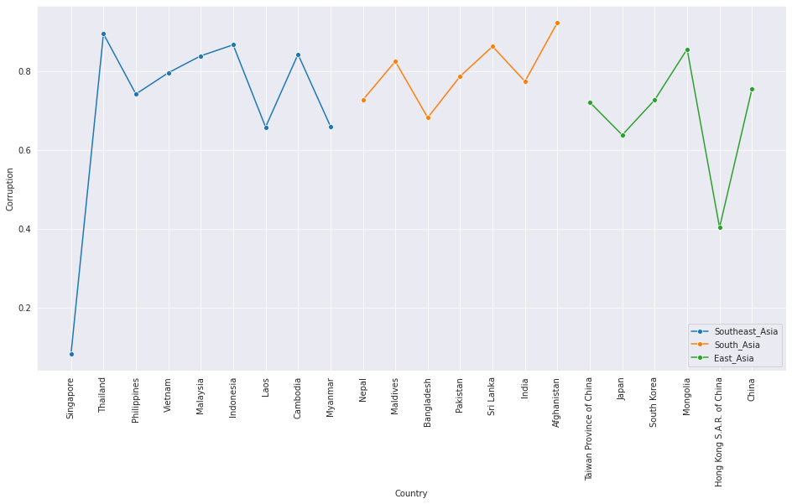
In 2021 Among Asian Countries which scores most in terms of Economy(GDP),Healthy Life Expectancy and Corruption ?

Slide 27
Singapore has the highest GDP(economy)rate among all Asian countries.
Among Asian Countries, India ranks 10th in Economy.
Singapore has the highest Healthy life expectancy.
India ranks 12th in Healthy Life Expectancy.
Afghanistan has the highest rate in corruption.
India is in the 10th position.

Slide 28
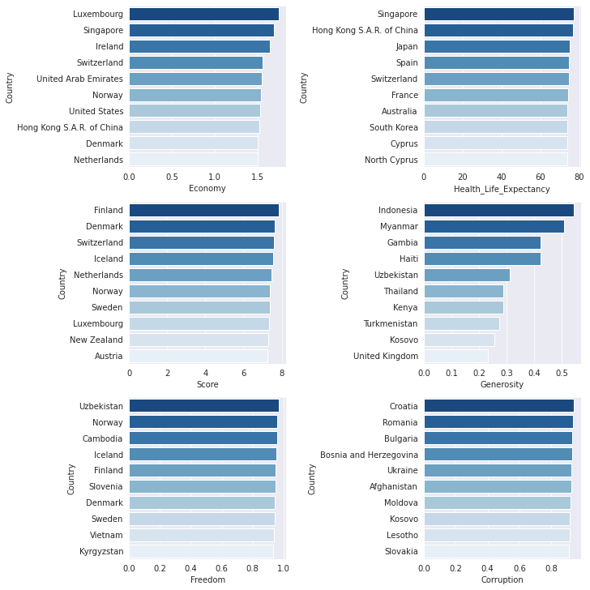
Analyse on different countries in the World
Let’s check which countries are better positioned in each of the aspects being analyzed among top 10 in 2021

Slide 29
In terms of GDP(Economy),Luxumberg tops among all
countries.
In terms of Happiness score Finland grabs the first position.
Uzbekistan has the most freedom of life.
Croatia tops in corruption.
Indonesia is in the first position for generosity.
In terms of Healthy life expectancy Singapore has the highest score.

Slide 30
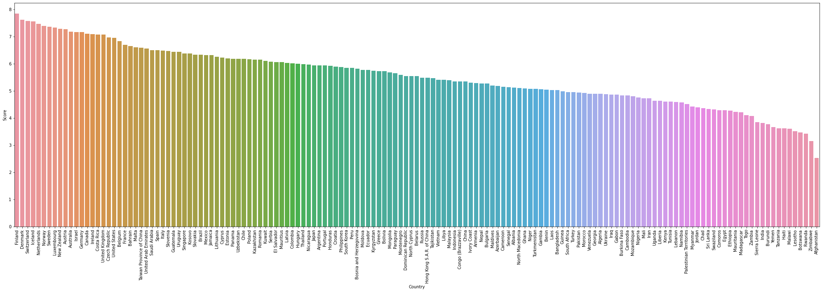
Ranking distribution of all Countries in year 2021according to the Happiness Score
Finland is in the first position,second comes Denmark and India is in the 139th position and at the last position is Afghanistan

Slide 31
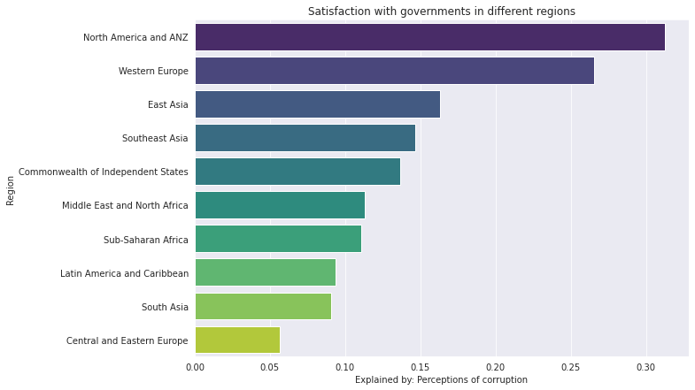
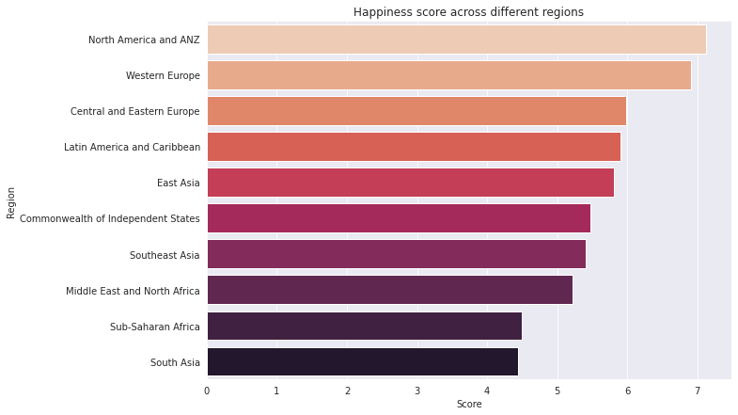
Visualisation of Satisfaction of people with their governments across different regions and Happiness score
As observed we can see that the North America and ANZ has the best trust score.
As per the graph,North America and ANZ has the highest happiness score. And South Asia in which our country India includes is in the bottom

Slide 32
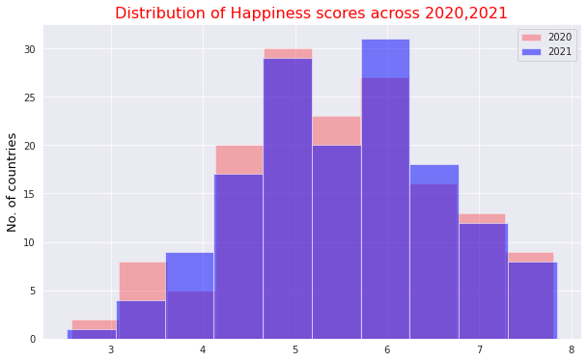
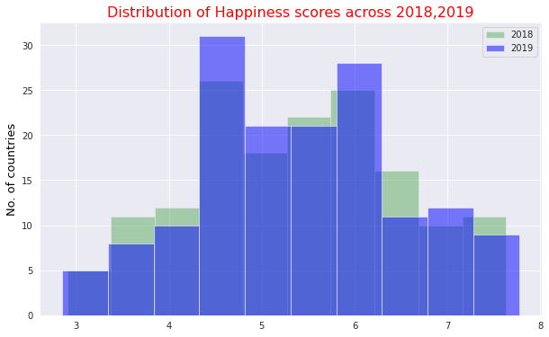
Have people been relatively more happier in coming years?
The stacked histogram plotted above shows that there has been an increase in the happiness score at the extremums as there appears to be a shift to the right in the year 2021. A significant increase in the number of countries with score between 5-6 has been observed. This may signify relatively better living standards and satisfaction of the people with their lives and the government in 2021.
We can conclude that people have been happier in 2021 as compared to 2020.
The stacked histogram plotted above shows that there has been an increase in the happiness score at the extremums as there appears to be a shift to the right in the year 2019. A significant increase in the number of countries with score between 4-5 has been observed. This may signify relatively better living standards and satisfaction of the people with their lives and the government in 2019.
We can conclude that people have been happier in 2019 as compared to 2018.

Slide 33
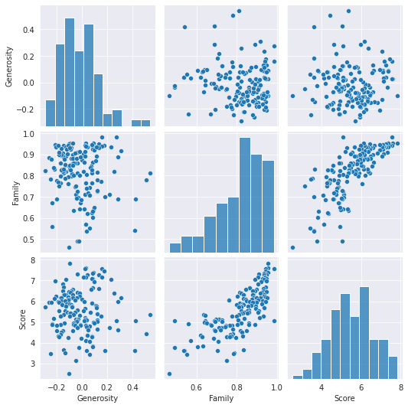
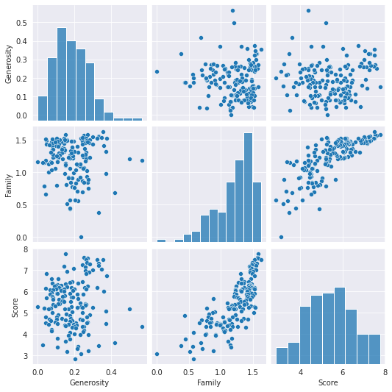
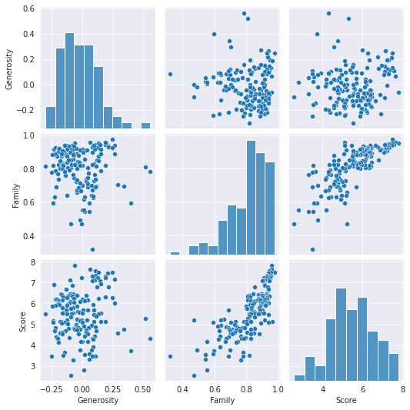
Correlation between Social support,Happiness score and Generoisty of year 2021,2020 and 2019.
As we observe in the above scatterplots, the linear relationships described between various factors and the Happiness Score have been justified. Scatter plots are a great source of identifying probable linear relationships between various features and can be used for feature selection.

Slide 34
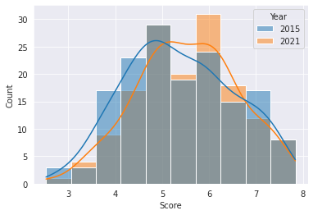
Comparing the happiness score of year 2015 and 2021
From the graph,its clear that the happiness score of countries has increased in 2021 compared to 2015.

Slide 35
CONCLUSION
Every year, the World Happiness Report provides rich insight into what makes humans happy and their lives worth living. We enjoyed the reminder that health, trust, generosity, having someone to count on, income and freedom are the core drivers of human happiness.
And if a human-first approach to marketing means anything, it means creating and communicating value around these six areas of human life.

Slide 36
More information about the survey:
https://worldhappiness.report/ed/2021/
Dataset collected from:
https://www.kaggle.com/mathurinache/world-happiness-report-20152021?select=2021.csv

Slide 37


